Slide 1
Disciplinary Discussions Using Text Sets
GRADE 5: TEXT SET B
research, presentations, & critical analysis tasks: Lessons 7B-10B

Slide 2

GUIDED MINI-RESEARCH PROJECT
LESSON 7B

Slide 3

ELD OBJECTIVE
In this lesson, you will collaborate with a partner to…
      select a question to research
      research your question online
      read and interpret the sources you select
      gather and document information you find about your question
      create a graphic organizer to share your findings with another pair
STUDENT FRIENDLY ELD OBJECTIVES
Notes:
COMMUNICATE THE PURPOSE OF THE LESSON - SHARE LESSON OBJECTIVES WITH STUDENTS

Slide 4

What question do you want to research?
We have learned a lot of information about our topic using various sources. Each time you encountered a new source, you learned something new, which led you to ask more questions. New learning makes you curious and generates questions that lead to deeper learning about the topic.
SELECT A QUESTION
  Take out your Note-Taking Graphic Organizers
  Review the different questions you posed
  What questions do you still have?
  What else are you curious about or want to learn about this topic?
  Narrow it down to two questions; then select just one
LET’S SHARE AND CHART SOME IDEAS
Notes:
NOTE: PARTNER STUDENTS UP STRATEGICALLY, SO THAT THEY WILL BE SUCCESSFUL WORKING TOGETHER ON THIS PROJECT. HAVE STUDENTS REVIEW THE VARIOUS QUESTIONS THEY’VE NOTED IN PREVIOUS LESSONSAND THINK ABOUT WHICH ONES THEY MIGHT WANT TO RESEARCH. HAVE A FEW STUDENTS SHARE OUT QUESTIONS AND CHART THEM UP FOR ALL OF THE STUDENTS TO SEE.

Slide 5

DECIDE ON A QUESTION TO RESEARCH
PARTNER WORK
  Have a Constructive Conversation with your partner to answer the following prompt:
  Which question will we research and why?
  You must come to a consensus.
Notes:
HAVE STUDENTS NEGOTIATE WHICH OF THE TWO QUESTIONS (ONE FOR EACH PARTNER) THEY WILL RESEARCH TOGETHER AND WHY.

Slide 6
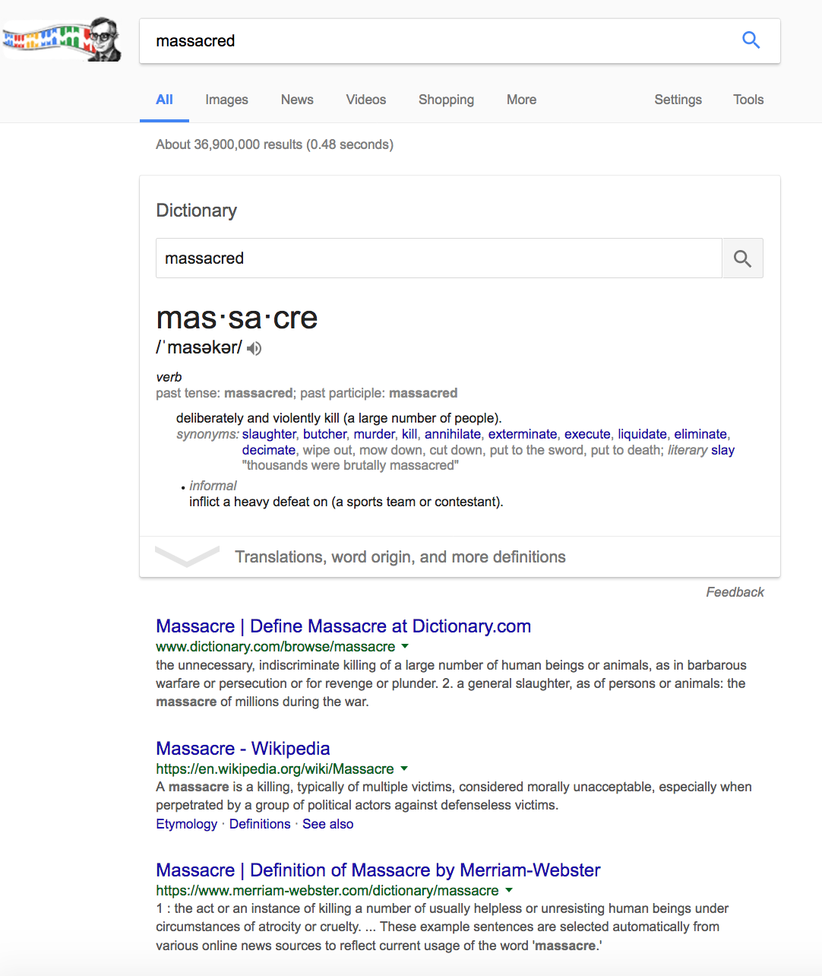
What question did I research?
My question:
What does massacred mean?
Step 1: Use an internet browser and type in your question or key words
Step 2: Decide which sources you will consult
Step 3: Read and interpret the information
Step 4: Keep good notes
    key information about your question
    other questions you think of as you continue your research
Notes:
MODEL HOW TO RESEARCH YOUR OWN QUESTION

Slide 7
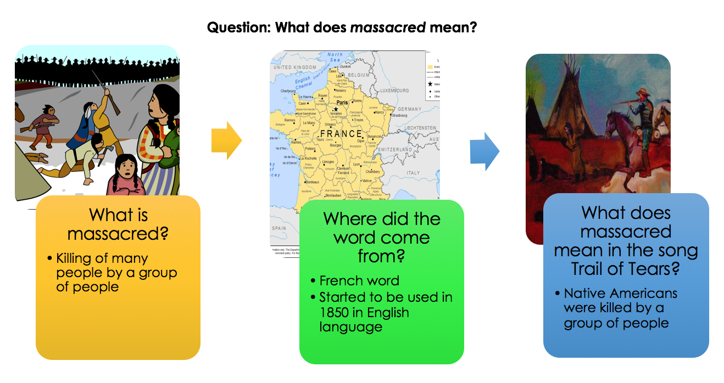
What were my research findings?
My question:
What does massacred mean?
Step 1: I used key words: massacred
Step 2: I decided to read the Wikipedia article.
Step 3: I read about what the word means and its origin
Step 4: I organized my notes. I included additional questions I thought of and what my sources were using a graphic organizer.
Notes:
MODEL HOW TO RESEARCH YOUR OWN QUESTION

Slide 8

CONDUCT YOUR RESEARCH
PARTNER WORK
Step 1: Use an internet browser and type in your question or key words
Step 2: Decide which sources you will consult
Step 3: Read and interpret the information
Step 4: Use a graphic organizer to keep good notes
    key information about your question
    other questions you think of as you continue your research
Notes:
STUDENTS CONDUCT RESEARCH

Slide 9


PAIRS SQUARE
Pairs Stand Up – Look for another pair to team up with
Make Eye Contact – Gesture to the pair to let them know you want to join them
Pairs Square – One pair walks across the room to the other pair and form a quad
Decide – Who is Pair #1 & Pair #2
PAIRS SQUARE – FORM A QUAD
Notes:
HAVE PAIRS FIND ANOTHER PAIR TO FORM A QUAD. HAVE THEM DECIDE WHO IS PAIR #1 AND PAIR#2, SO THEY ARE READY FOR THE NEXT STEP.

Slide 10
RESEARCH
Give and Receive Feedback
PAIR #1
Collaborate with your partner to present your research findings using a graphic organizer
Remember to…
  Explain each piece of key information you found and what your source was
  How it connects to your research question
  Any additional questions generated by your research
Ask the other pair for their feedback
PAIR #2
Listen actively as the other pair presents
Provide specific feedback about each:
  How did they answer their research question?
  Did they have good sources? How do you know?
  As the audience, what questions do you still have?
What is one thing they could improve? How?
SWITCH
SHARE IN YOUR QUADS – GIVE & RECEIVE FEEDBACK
Notes:
STUDENT PAIRS TAKE TURNS SHARING THEIR FINDINGS. WHILE ONE PAIR PRESENTS, THE OTHER PAIRS LISTENS IN ORDER TO GIVE AND RECEIVE FEEDBACK. THEN THEY SWITCH ROLES.

Slide 11
REFLECT:
What is our next step?
What feedback did we receive? How can we use it to refine our research?
Are the sources we have so far reliable? How do we know?
How will we present our findings?

Slide 12
REFINE YOUR RESEARCH
PARTNER WORK
  Have a Constructive Conversation with your partner to answer the following prompt:
  What is our next step in the research process and how will we present our findings?
Notes:
HAVE STUDENTS NEGOTIATE WHICH OF THE TWO QUESTIONS (ONE FOR EACH PARTNER) THEY WILL RESEARCH TOGETHER AND WHY.

Slide 13
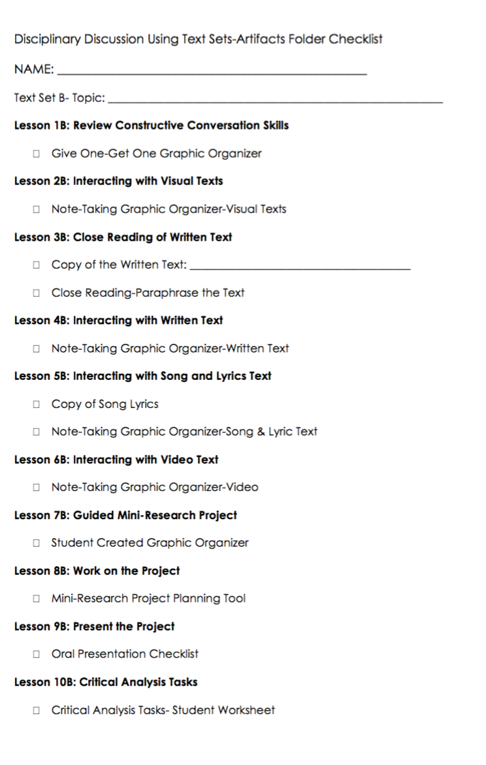

Artifacts Folder
Trail of Tears
✓
✓
✓
Trail of Tears
✓
Place your Note-Taking Graphic Organizer in your Artifacts Folder
Use the checklist to mark each task as you complete it
✓
✓
✓
✓
✓
Notes:
Remind students to keep her/his artifacts in their artifacts folder

Slide 14


REVIEW ELD OBJECTIVE & SELF-ASSESS
In this lesson, you…
      selected a question to research
      researched your question online
      read and interpreted the sources you selected
      gathered and documented information you found about your question
      created a graphic organizer to share your findings with another pair
Think…
    What helped you complete your research?
Work with your Constructive Conversation partner to:
Identify one thing that you did well and one thing you want to improve
Share and explain to your partner
TURN & TALK
TURN & TALK - THEN WHOLE GROUP DISCUSSION
Notes:
After students have had a few minutes to discuss with a partner, call on one or two individuals to share out with the whole group.

Slide 15
WORK ON THE PROJECT
LESSON 8B

Slide 16
ELD OBJECTIVE
In this lesson, you will collaborate with a partner to…
      understand the criteria for the project
      review the information you’ve gathered
      determine if you need to continue your research
      create the slides for your project
      share the slides with another pair
      give and receive feedback to revise your slides
STUDENT FRIENDLY ELD OBJECTIVES
Notes:
COMMUNICATE THE PURPOSE OF THE LESSON - SHARE LESSON OBJECTIVES WITH STUDENTS

Slide 17
REFINE YOUR RESEARCH
PARTNER WORK
  Have a Constructive Conversation with your partner to answer the following prompt:
  What is our next step in the research process and how will we present our findings?
Notes:
HAVE STUDENTS DISCUSS THE PROMPT.

Slide 18

Research Project Criteria
Slide 1 contains a relevant title.
Slide 2 contains your research question and a visual.
Slide 3 contains your one finding and a visual.
Slide 4 contains a second finding and a visual.
Slide 5 contains a new question you now have and next steps for continuing research.
All slides (text and visual components) are organized/structured to address the research question.
Notes:
PRESENT RESEARCH PROJECT CRITERIA TO STUDENTS.

Slide 19
Add a catchy title that represents your central theme
Don’t forget to add your names and date
Presented by: _____________________
Notes:
Hi I’m ________ and I am here to tell you about why healthy food is beneficial.
Read title: I Love Healthy Food.
Click 1: You Should, Too!

Slide 20
Question:
What is your
question?
Images add detail to your slides, include one or more.
Notes:
Did you know that eating healthy food such as fruits and vegetables is good for you?
Click 1: Well, one benefit of eating healthy food is that it leads to a happier life. When you are healthy you are happier.
Click 2:Another benefit of eating healthy food is that it helps you think and learn better.

Slide 21
What we found—Finding 1:
This slide presents the first finding. Make sure you include how it connects to your question and what your source is.
Images add detail to your slides, include one or more.
Notes:
Like I said, one reason to eat healthy food is that it leads to a happier life.
Click 1: For example, when you eat junk food, it makes your body unhealthy. When your body is not healthy, you get sick a lot, which is not fun.
Click 2: Additionally, when your body is healthy you don’t get sick and you have more energy and time to have fun.

Slide 22
What we found—Finding 2:
This slide presents the first finding. Make sure you include how it connects to your question and what your source is.
Images add detail to your slides, include one or more.
Notes:
Like I said, one reason to eat healthy food is that it leads to a happier life.
Click 1: For example, when you eat junk food, it makes your body unhealthy. When your body is not healthy, you get sick a lot, which is not fun.
Click 2: Additionally, when your body is healthy you don’t get sick and you have more energy and time to have fun.

Slide 23
Additional Questions
This slide is for you to explore the following questions:
What other questions were generated by your research?
If you were to continue your research, what would be your next step?
Notes:
This is an informational video that provides additional information about the benefits of eating healthy foods.

Slide 24
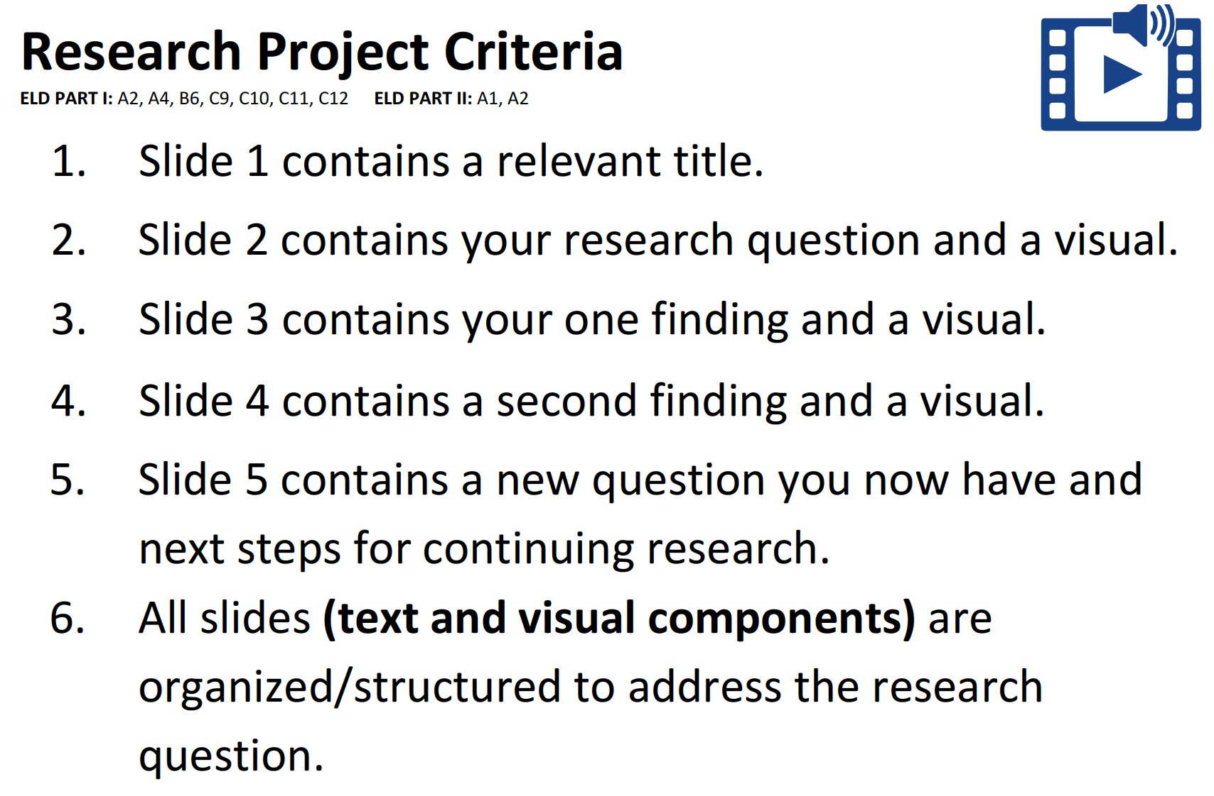
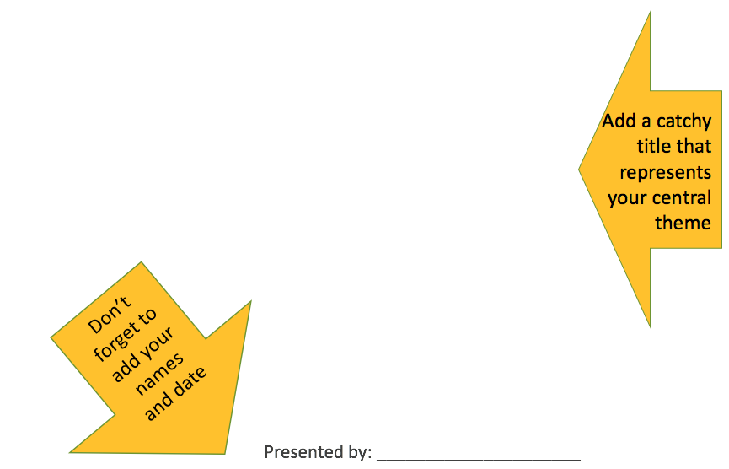
WORK ON THE PROJECT
PARTNER WORK
Collaborate with your partner to…
understand the criteria for the project
review the information you have gathered
determine if you need to continue your research
use the Project Planning Tool to create the slides for your project
Notes:
PRESENT DIRECTIONS FOR PARTNER WORK. PROVIDE STUDENTS WITH SUFFICIENT TIME TO COMPLETE THE TASK. CIRCULATE TO SUPPORT STUDENTS.

Slide 25
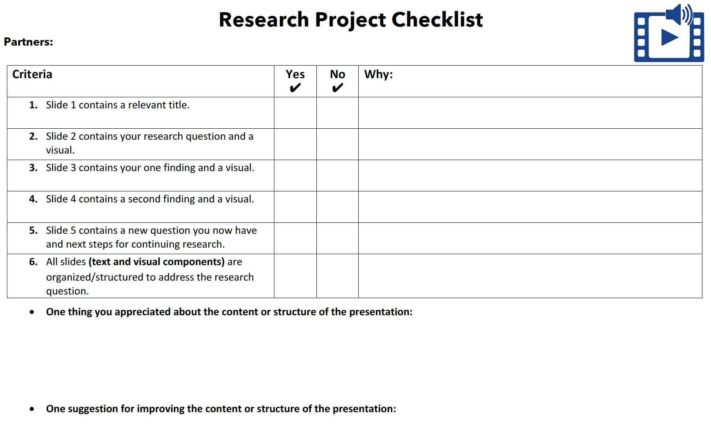
Notes:
PROVIDE STUDENTS WITH A COPY OF THE RESEARCH PROJECT CHECKLIST. ORIENT THEM TO THE DIFFERENT SECTIONS, SO THEY ARE PREPARED TO USE IT.

Slide 26




Present your project slides
Give and receive feedback
ORAL PRESENTATION
FISHBOWL MODEL
Listen actively as two of your peers present
How did they meet the criteria?
What feedback can we give them?
TURN & TALK
FORMATIVE ASSESSMENT– TEACHER COLLECTS LANGUAGE SAMPLE SPF OOAT – MULTIPLE SPEAKERS
Notes:
SELECT A PAIR TO ORALLY PRESENT TO THE CLASS. COLLECT A LANGUAGE SAMPLE USING THE SPF OOAT.
USE THE LISTED CRITERIA TO DEBRIEF THE FISHBOWL AND MODEL GIVING FEEDBACK TO STUDENTS.

Slide 27
PAIRS SQUARE
Pairs Stand Up – Look for another pair to team up with
Make Eye Contact – Gesture to the pair to let them know you want to join them
Pairs Square – One pair walks across the room to the other pair and form a quad
Decide – Who is Pair #1 & Pair #2
PAIRS SQUARE – FORM A QUAD
Notes:
HAVE PAIRS FIND ANOTHER PAIR TO FORM A QUAD. HAVE THEM DECIDE WHO IS PAIR #1 AND PAIR#2, SO THEY ARE READY FOR THE NEXT STEP.

Slide 28
Give & Receive Feedback
PAIR #1
Collaborate with your partner to present your project slides
Remember to…
  Take turns with your partner to present the slides
  Ask the other pair for their feedback
PAIR #2
Listen actively as the other pair presents
Use the Research Project Checklist to provide specific feedback
SWITCH
SHARE IN YOUR QUADS – GIVE & RECEIVE FEEDBACK
Notes:
STUDENT PAIRS TAKE TURNS SHARING THEIR PROJECT SLIDES. WHILE ONE PAIR PRESENTS, THE OTHER PAIRS LISTENS IN ORDER TO GIVE AND RECEIVE FEEDBACK. THEN THEY SWITCH ROLES.

Slide 29
REVISE THE PROJECT &
USE TECHNOLOGY TO CREATE THE PRESENTATION
PARTNER WORK
Collaborate with your partner to…
use the feedback you received to revise your presentation
use technology to create the presentation
save the file so that it is ready to present
Notes:
PROVIDE STUDENTS WITH ACCESS TO TECHNOLOGY TO CREATE THEIR SLIDES USING AN APPLICATION SUCH AS PPT OR KEYNOTE. PROVIDE SUFFICIENT TIME TO COMPLETE THE TASK. CIRCULATE TO SUPPORT STUDENTS.

Slide 30
Artifacts Folder
Trail of Tears
✓
✓
✓
Trail of Tears
✓
Place your Project Planning Tool in your Artifacts Folder
Use the checklist to mark each task as you complete it
✓
✓
✓
✓
✓
✓
Notes:
Remind students to keep her/his artifacts in their artifacts folder

Slide 31
REVIEW ELD OBJECTIVE & SELF-ASSESS
In this lesson, you…
      worked to understand the criteria for the project
      reviewed the information you gathered
      determined if you needed to continue your research
      created the slides for your project
      shared the slides with another pair
      gave and received feedback to revise your slides
Think…
    What helped you complete your project?
Work with your Constructive Conversation partner to:
Identify one thing that you did well and one thing you want to improve
Share and explain to your partner
TURN & TALK
TURN & TALK - THEN WHOLE GROUP DISCUSSION
Notes:
After students have had a few minutes to discuss with a partner, call on one or two individuals to share out with the whole group.

Slide 32
PRESENT THE PROJECT
LESSON 9B

Slide 33
ELD OBJECTIVE
In this lesson, you will collaborate with a partner to…
      understand the criteria for the oral presentation
      plan and practice before your present
      present to another pair
      give and receive feedback
      reflect on the mini-research process
STUDENT FRIENDLY ELD OBJECTIVES
Notes:
COMMUNICATE THE PURPOSE OF THE LESSON - SHARE LESSON OBJECTIVES WITH STUDENTS

Slide 34

Oral Presentation
Criteria
During your presentation you will…
use complex language and complete sentences
take turns when presenting
stay on topic
use eye contact and speak appropriately and clearly
explain the language and the images in the presentation
answer questions from the audience
Notes:
PRESENT ORAL PRESENATION CRITERIA TO STUDENTS.

Slide 35
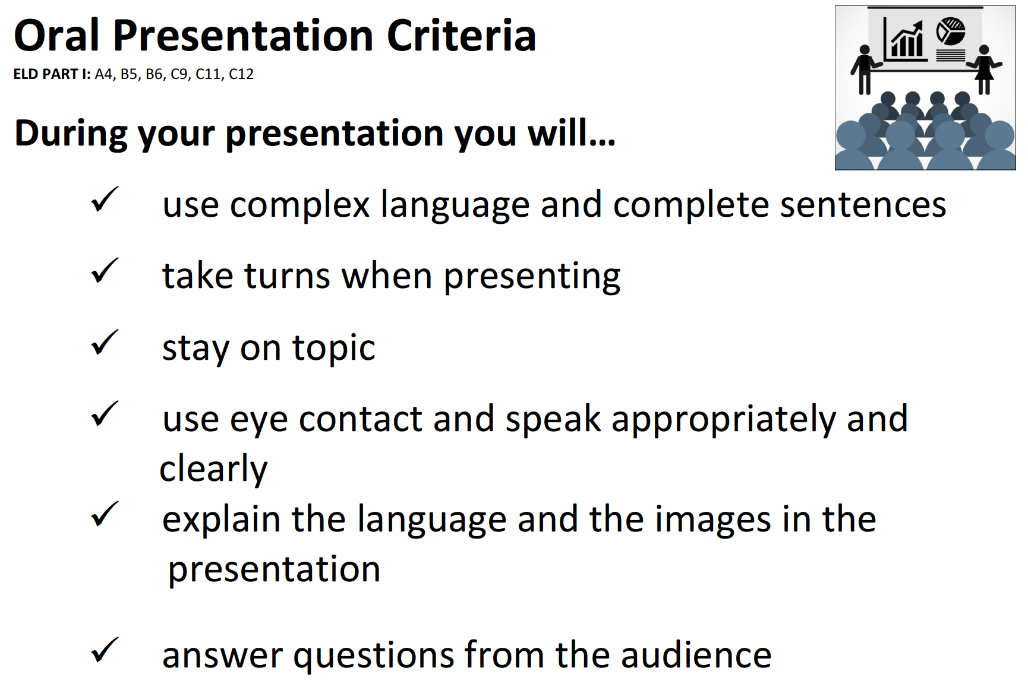
PLAN & PRACTICE PRESENTING
PARTNER WORK
Collaborate with your partner to…
plan how you will present
practice presenting with your partner
be ready to present to another pair
Notes:
PROVIDE STUDENTS WITH ACCESS TO TECHNOLOGY TO CREATE THEIR SLIDES USING AN APPLICATION SUCH AS PPT OR KEYNOTE. PROVIDE SUFFICIENT TIME TO COMPLETE THE TASK. CIRCULATE TO SUPPORT STUDENTS.

Slide 36
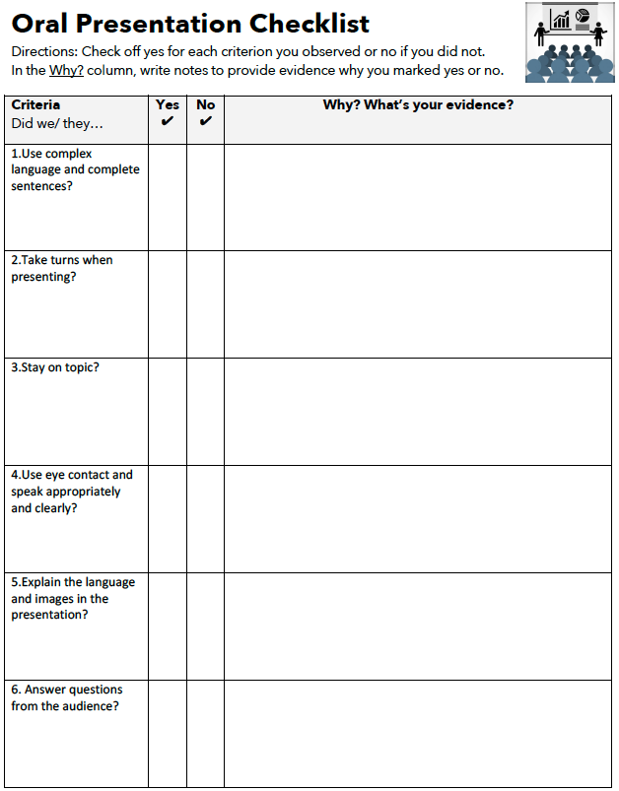
ORAL PRESENTATION
FISHBOWL MODEL
Present your project slides
Give and receive feedback
Listen actively as two of your peers present
How did they meet the criteria?
What feedback can we give them?
TURN & TALK
FORMATIVE ASSESSMENT– TEACHER COLLECTS LANGUAGE SAMPLE SPF OOAT – MULTIPLE SPEAKERS
Notes:
SELECT A PAIR TO ORALLY PRESENT TO THE CLASS. COLLECT A LANGUAGE SAMPLE USING THE SPF OOAT.
USE THE LISTED CRITERIA TO DEBRIEF THE FISHBOWL AND MODEL GIVING FEEDBACK TO STUDENTS.

Slide 37
PAIRS SQUARE
Pairs Stand Up – Look for another pair to team up with
Make Eye Contact – Gesture to the pair to let them know you want to join them
Pairs Square – One pair walks across the room to the other pair and form a quad
Decide – Who is Pair #1 & Pair #2
PAIRS SQUARE – FORM A QUAD
Notes:
HAVE PAIRS FIND ANOTHER PAIR TO FORM A QUAD. HAVE THEM DECIDE WHO IS PAIR #1 AND PAIR#2, SO THEY ARE READY FOR THE NEXT STEP.

Slide 38
Give & Receive Feedback
PAIR #1
Collaborate with your partner to present your project slides
Remember to…
  Take turns with your partner to present the slides
  Ask the other pair for their feedback
PAIR #2
Listen actively as the other pair presents
Use the Oral Presentation Checklist to provide specific feedback
SWITCH
SHARE IN YOUR QUADS – GIVE & RECEIVE FEEDBACK
Notes:
STUDENT PAIRS TAKE TURNS PRESENTING THEIR PROJECT SLIDES. WHILE ONE PAIR PRESENTS, THE OTHER PAIRS LISTENS IN ORDER TO GIVE AND RECEIVE FEEDBACK. THEN THEY SWITCH ROLES.

Slide 39
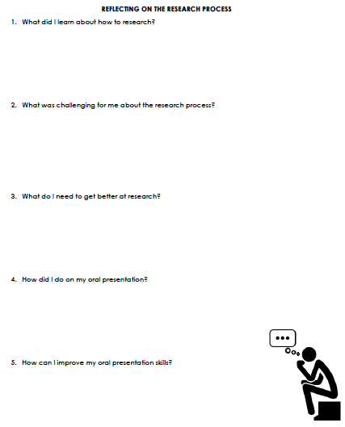
TIME TO REFLECT
EXIT TICKET
Use your think time to reflect on each question
Answer each question and turn it in when you are done
Notes:
HAVE EACH STUDENT COMPLETE THE REFLECTION AND TURN IT IN.

Slide 40
Artifacts Folder
Trail of Tears
✓
✓
✓
Trail of Tears
✓
Place your Oral Presentation Checklist in your Artifacts Folder
Use the checklist to mark each task as you complete it
✓
✓
✓
✓
✓
✓
✓
Notes:
Remind students to keep her/his artifacts in their artifacts folder

Slide 41
REVIEW ELD OBJECTIVE & SELF-ASSESS
In this lesson, you…
      worked to understand the criteria for the oral presentation
      planned and practiced before to present
      presented to another pair
      gave and received feedback
      reflected on the mini-research process
Work with your Constructive Conversation partner to:
Identify one thing that you did well and one thing you want to improve
Share and explain to your partner
TURN & TALK
TURN & TALK - THEN WHOLE GROUP DISCUSSION
Notes:
After students have had a few minutes to discuss with a partner, call on one or two individuals to share out with the whole group.

Slide 42
CRITICAL ANALYSIS TASKS
LESSON 10B

Slide 43
FIND YOUR LEARNING PARTNERS
For this lesson, you will work collaboratively with different partners to complete five tasks.
Find a different partner for each landmark
Try to keep your partnerships gender balanced (about half girls and half boys)
Write down their names so you remember who they are

Slide 44
ELD OBJECTIVE
In this lesson, you will collaborate with a partner to…
      identify the strongest evidence (TASK 1)
      match ideas to corresponding sources (TASK 2)
      choose a source and explain why it is more useful (TASK 3)
      support an idea from one text with evidence from another text (TASK 4)
      complete a short written response using evidence from three texts (TASK 5)
STUDENT FRIENDLY ELD OBJECTIVES
Notes:
COMMUNICATE THE PURPOSE OF THE LESSON - SHARE LESSON OBJECTIVES WITH STUDENTS

Slide 45
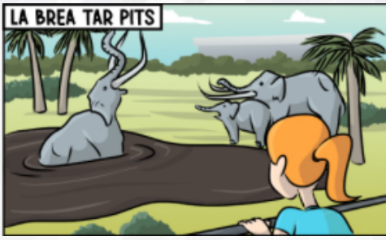
TASK 1
  Find your La Brea Tar Pits Partner and prepare to work on Task #1.

Slide 46
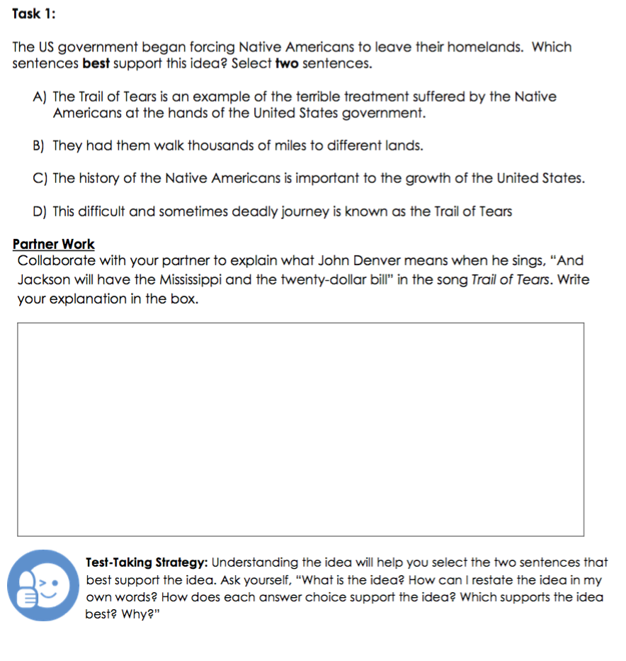
TASK 1
Identify the Strongest Evidence
The US government began forcing
Native Americans to leave their homelands.
Which sentences best support this idea?
Select two sentences.
TEST-TAKING STRATEGY
Understanding the idea will help you select the two sentences that best support the idea.
The US government began forcing Native Americans to leave their homelands. Which sentences best support this idea? Select two sentences.
PARTNER WORK
Underline the idea.
Collaborate with your partner to paraphrase the idea.
Write your paraphrase in the box.
TURN & TALK
DISCUSS WITH A PARTNER
Notes:
REVIEW TASK #1 AND HAVE STUDENTS DISCUSS & UNDERSTAND THE IDEA. THEY SHOULD WORK TOGETHER TO PARAPHRASE THE IDEA. THIS WILL HELP THEM UNDERSTAND THE IDEA IN ORDER TO SELECT THE TWO SENTENCES THAT BEST SUPPORT THE IDEA.

Slide 47

TASK 1
Identify the Strongest Evidence
SHARE OUT
Listen actively to each paraphrase. Think about how it helps you understand the idea.
IDEA: The US government began forcing Native Americans to leave their homelands.
PARAPHRASE |  | HOW DID IT HELP YOU UNDERSTAND THE IDEA?
PAIR 1:
PAIR 2:
WHOLE-GROUP SHARE OUT
Notes:
SELECT TWO PAIRS TO COME UP AND SHARE THEIR PARAPHRASE.
SAY: LISTEN AS EACH PAIR SHARES HOW THEY PARAPHRASED THE IDEA. THINK ABOUT HOW IT HELPS YOU UNDERSTAND THE IDEA. I WILL CHART OUR THINKING.

Slide 48
TASK 1
Identify the Strongest Evidence
The US government began forcing
Native Americans to leave their homelands.
Which sentences best support this idea?
Select two sentences.
PARTNER WORK:
Read each answer choice.
Eliminate two weak answer choices.
With your partner, come to a consensus on the two sentences that best support the idea.
Be prepared to explain your decision to another pair.
TURN & TALK
COME TO A CONSENSUS
Notes:
HAVE STUDENTS COLLABORATE WITH A PARTNER TO SELECT THE TWO SENTENCES THAT BEST SUPPORT THE IDEA. THEY MUST COME TO A CONSENSUS AND SHARE WITH ANOTHER PAIR.

Slide 49
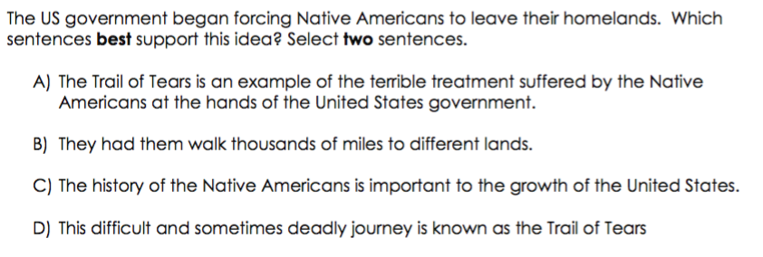
TASK 1
Identify the Strongest Evidence
WHY DO THESE TWO SENTENCES BEST SUPPORT THE IDEA?
TURN & TALK
EXPLAIN & JUSTIFY THE ANSWERS
Notes:
HAVE STUDENTS DISCUSS WHY THESE TWO SENTENCES BEST SUPPORT THE IDEA.
C – SHOULD BE EASY TO ELIMINATE
B & D – PROVIDE THE MOST DETAILED SUPPORTING EVIDENCE TO SUPPORT THE IDEA
A & E – EVEN THOUGH THESE TWO SENTENCES WOULD WORK AS SUPPORTING EVIDENCE, THEY PROVIDE LESS DETAILS THAN B & D

Slide 50
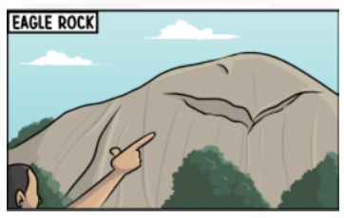
TASK 2
  Find your Eagle Rock Partner and prepare to work on Task #2.

Slide 51
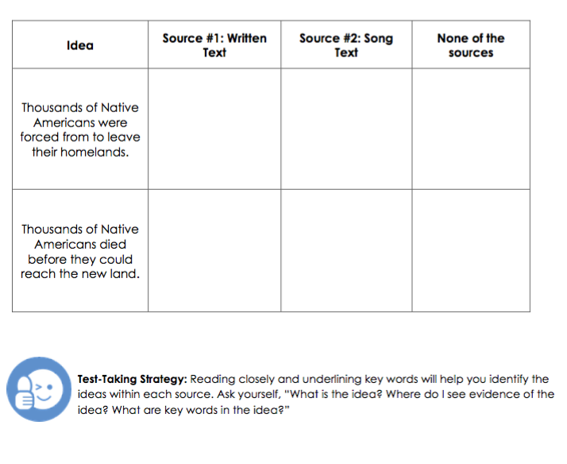
TASK 2
Match Ideas to Corresponding Choices
PARTNER WORK
Read each idea.
Collaborate with your partner to find evidence in each source.
Underline the evidence and check off the appropriate box.
TEST-TAKING STRATEGY
Reading closely and underlining key words will help you identify the ideas within each source.
Ask yourself:
What is the idea?
Where do I see evidence of the idea?
What are key words in the idea?
TURN & TALK
DISCUSS WITH A PARTNER
Notes:
READ THE DIRECTIONS. GIVE STUDENTS TIME TO WORK TOGETHER. REVIEW THE TEST-TAKING STRATEGY WITH THEM.

Slide 52
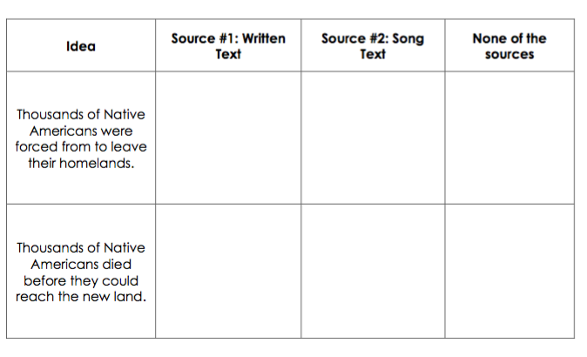
TASK 2
Match Ideas to Corresponding Choices
✓
TURN & TALK
✓
SHARE OUT
EXPLAIN & JUSTIFY THE ANSWERS
Notes:
PROVIDE ANSWERS. HAVE STUDENTS TURN TO EXPLAIN AND JUSTIFY THE ANSWERS. SELECT A FEW STUDENTS TO SHARE OUT.

Slide 53
TASK 3
  You will continue to work with your Eagle Rock Partner. Prepare to work on Task #3.

Slide 54
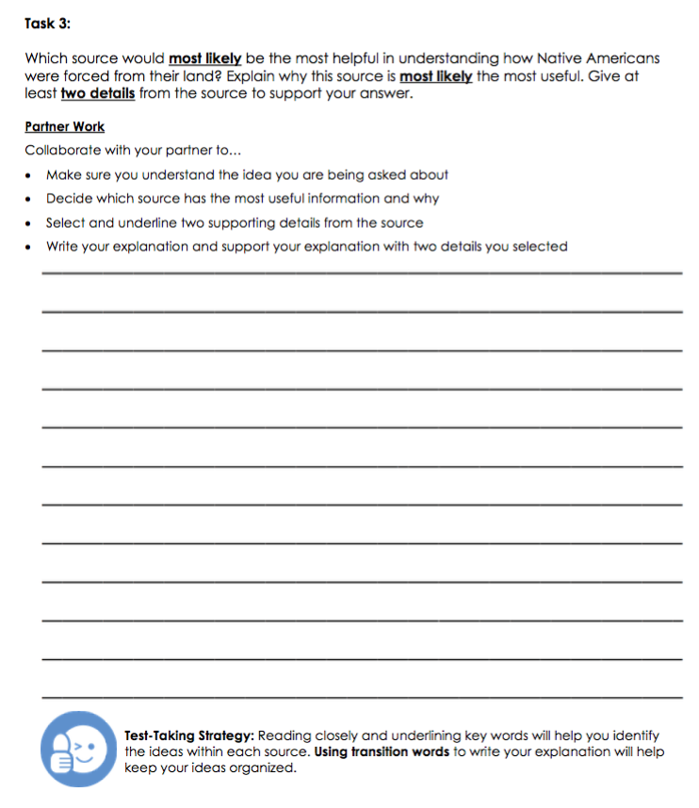
TASK 3
Choose a Source and Explain Why
PARTNER WORK
Collaborate with your partner to…
Make sure you understand the idea you are being asked about
Decide which source has the most useful information & be able to explain why
Select and underline two supporting details from the source
Write your explanation and support your explanation with the two details you selected
TURN & TALK
TEST-TAKING STRATEGY
Using transition words to write your explanation will help keep your ideas organized.
DISCUSS WITH A PARTNER
Notes:
READ THE TASK WITH THE STUDENTS. EXPLAIN THE DIRECTIONS FOR PARTNER WORK. REVIEW THE TEST-TAKING STRATEGY. PROVIDE STUDENTS TIME TO COLLABORATIVELY COMPLETE THE TASK.

Slide 55
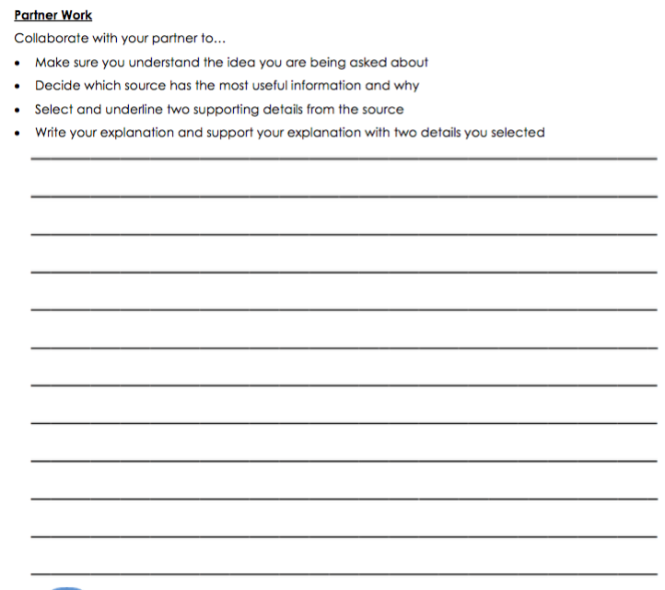
ORAL PRESENTATION
FISHBOWL MODEL
Present your ideas
Give and receive feedback
Listen attentively as two of your peers present
Provide specific feedback about each:
  How did they explain which source they chose and why?
  How did they use details from the source to support their explanation?
  How did they use transition words?
What is one thing they could improve? How?
TURN & TALK
FORMATIVE ASSESSMENT– TEACHER COLLECTS LANGUAGE SAMPLE SPF OOAT – MULTIPLE SPEAKERS
Notes:
SELECT A PAIR TO ORALLY PRESENT WHAT THEY WROTE FOR TASK 3 TO THE CLASS. COLLECT A LANGUAGE SAMPLE USING THE SPF OOAT.
USE THE LISTED CRITERIA TO DEBRIEF THE FISHBOWL AND MODEL GIVING FEEDBACK TO STUDENTS.

Slide 56
PAIRS SQUARE
Pairs Stand Up – Look for another pair to team up with
Make Eye Contact – Gesture to the pair to let them know you want to join them
Pairs Square – One pair walks across the room to the other pair and form a quad
Decide – Who is Pair #1 & Pair #2
PAIRS SQUARE – FORM A QUAD
Notes:
HAVE PAIRS FIND ANOTHER PAIR TO FORM A QUAD. HAVE THEM DECIDE WHO IS PAIR #1 AND PAIR#2, SO THEY ARE READY FOR THE NEXT STEP.

Slide 57
TASK 3
Choose a Source and Explain Why
PAIR #1
Collaborate with your partner to present your written explanation to Pair #2
Remember to…
  Explain which source you chose and explain why
  Give two supporting details from the source
  Use transition words
Ask the other pair for their feedback
PAIR #2
Listen actively as the other pair presents
Provide specific feedback about each:
  How did they explain which source they chose and why?
  How did they use details from the source to support their explanation?
  How did they use transition words?
What is one thing they could improve? How?
SWITCH
SHARE IN YOUR QUADS – GIVE & RECEIVE FEEDBACK
Notes:
STUDENT PAIRS TAKE TURNS SHARING WHAT THEY WROTE FOR TASK 3. WHILE ONE PAIR PRESENTS, THE OTHER PAIRS LISTENS IN ORDER TO GIVE AND RECEIVE FEEDBACK. THEN THEY SWITCH ROLES.

Slide 58
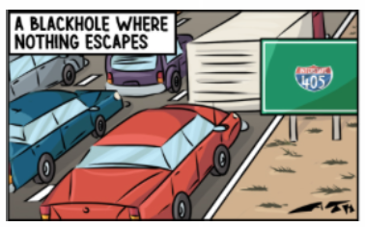
TASK 4
  Find your 405 Freeway Partner and prepare to work on Task #4.

Slide 59
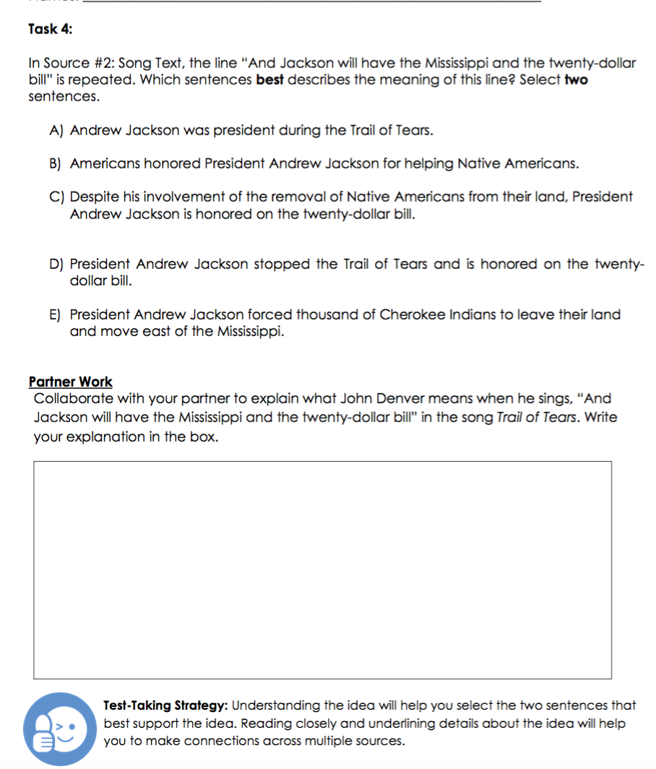
TASK 4
Support an idea from one text with evidence from another text
In Source #2: Song Text, the line “And Jackson will have the Mississippi and the twenty-dollar bill” is repeated.
Which sentences best describe the meaning of this line? Select two sentences.
TEST-TAKING STRATEGY
Understanding the idea will help you select the two sentences that best support the idea. Reading closely and underlining details about the idea will help you to make connections across multiple sources.
PARTNER WORK
Collaborate with your partner to explain what Bob Marley means when he sings, “fighting for survival” in the song Buffalo Soldier.
Underline details in Source #1 that support your idea.
Write your explanation in the box.
TURN & TALK
DISCUSS WITH A PARTNER
Notes:
REVIEW TASK #1 AND HAVE STUDENTS DISCUSS & UNDERSTAND THE IDEA. THEY SHOULD WORK TOGETHER TO PARAPHRASE THE IDEA. THIS WILL HELP THEM UNDERSTAND THE IDEA IN ORDER TO SELECT THE TWO SENTENCES THAT BEST SUPPORT THE IDEA.

Slide 60
TASK 4
Support an idea from one text with evidence from another text
SHARE OUT
Listen actively to each explanation. Think about how it helps you understand the idea.
IDEA: In Source #2: Song Text, the line “And Jackson will have the Mississippi and the twenty-dollar bill” is repeated
PARAPHRASE |  | HOW DID IT HELP YOU UNDERSTAND THE IDEA?
PAIR 1:
PAIR 2:
WHOLE-GROUP SHARE OUT
Notes:
SELECT TWO PAIRS TO COME UP AND SHARE THEIR EXPLANATION.
SAY: LISTEN AS EACH PAIR SHARES HOW THEY PARAPHRASED THE IDEA. THINK ABOUT HOW IT HELPS YOU UNDERSTAND THE IDEA. I WILL CHART OUR THINKING.

Slide 61
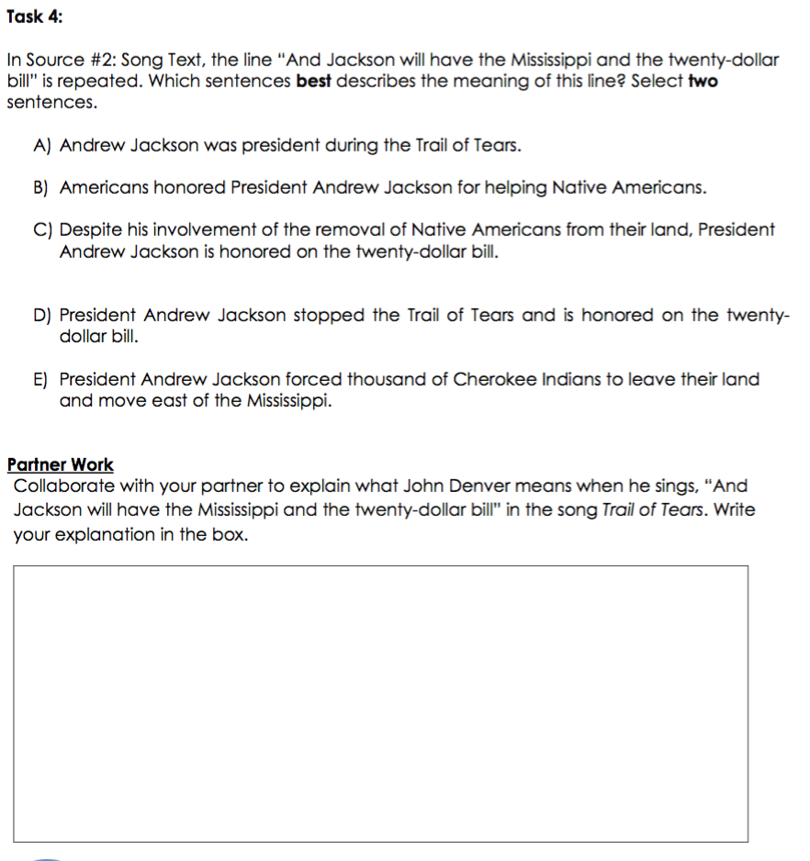
TASK 4
Support an idea from one text with evidence from another text
In Source #2: Song Text, the line “And Jackson will have the Mississippi and the twenty-dollar bill” is repeated.
Which sentences best describe the meaning of this line? Select two sentences.
PARTNER WORK:
Read each answer choice.
Eliminate two weak answer choices.
With your partner, come to a consensus on the two sentences that best support the idea.
Be prepared to explain your decision to another pair.
TURN & TALK
COME TO A CONSENSUS
Notes:
HAVE STUDENTS COLLABORATE WITH A PARTNER TO SELECT THE TWO SENTENCES THAT BEST SUPPORT THE IDEA. THEY MUST COME TO A CONSENSUS AND SHARE WITH ANOTHER PAIR.

Slide 62
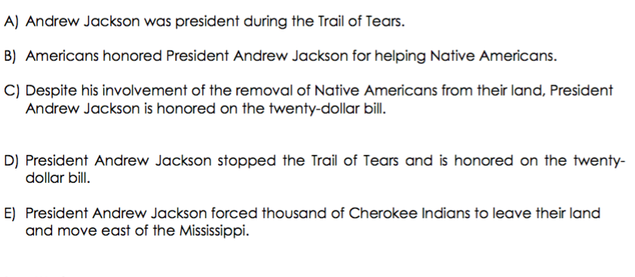
TASK 4
Support an idea from one text with evidence from another text
WHY DO THESE TWO SENTENCES BEST SUPPORT THE IDEA?
TURN & TALK
EXPLAIN & JUSTIFY THE ANSWERS
Notes:
HAVE STUDENTS DISCUSS WHY THESE TWO SENTENCES BEST SUPPORT THE IDEA.
B, C, & D – SHOULD BE EASY TO ELIMINATE
A & D – PROVIDE THE MOST DETAILED SUPPORTING EVIDENCE TO SUPPORT THE IDEA OF “FIGHTING FOR SURVIVAL” AS STATED IN THE SONG TEXT.

Slide 63
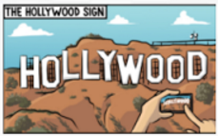
TASK 5
  Find your Hollywood Partner and prepare to work on Task #5.

Slide 64
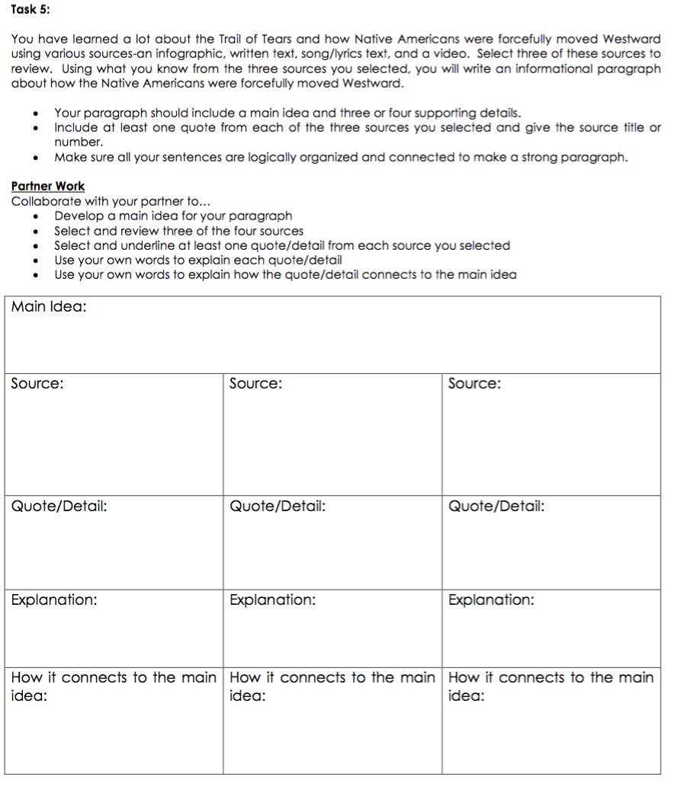


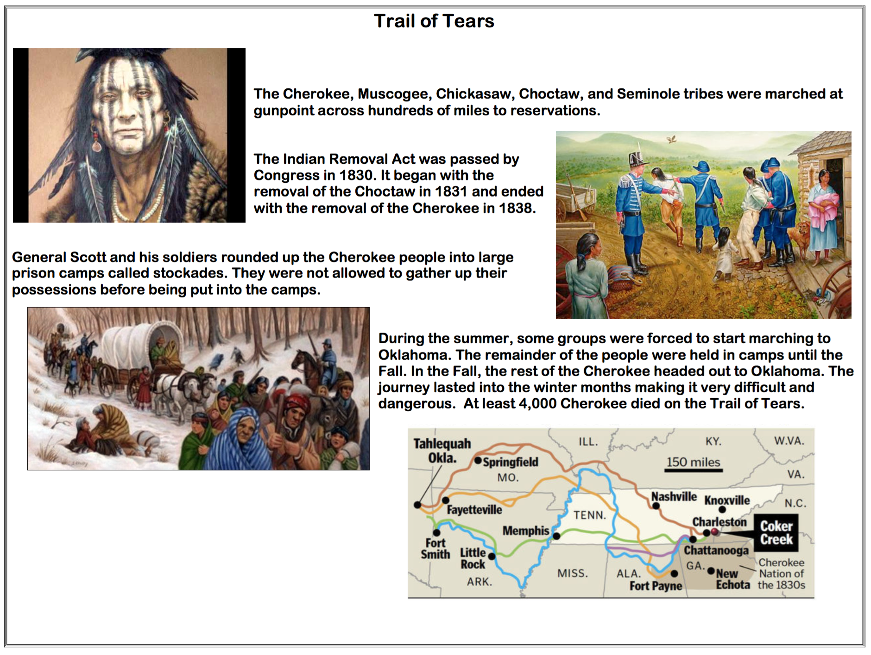
TASK 5
Short written response using evidence from three texts
PARTNER WORK
Use the graphic organizer and collaborate with your partner to…
Develop a main idea for your paragraph
Select and review three of the four sources
Select/underline at least one quote/detail from each source you selected
Use your own words to explain each quote/detail
Use your own words to explain how the quote/detail connects to the main idea
DISCUSS WITH A PARTNER
Notes:
READ THE TASK WITH THE STUDENTS. EXPLAIN THE DIRECTIONS FOR PARTNER WORK. PROVIDE STUDENTS TIME TO COLLABORATIVELY COMPLETE THE TASK.

Slide 65
PAIRS SQUARE
Pairs Stand Up – Look for another pair to team up with
Make Eye Contact – Gesture to the pair to let them know you want to join them
Pairs Square – One pair walks across the room to the other pair and form a quad
Decide – Who is Pair #1 & Pair #2?
PAIRS SQUARE – FORM A QUAD
Notes:
HAVE PAIRS FIND ANOTHER PAIR TO FORM A QUAD. HAVE THEM DECIDE WHO IS PAIR #1 AND PAIR#2, SO THEY ARE READY FOR THE NEXT STEP.

Slide 66
TASK 5
Short written response using evidence from three texts
PAIR #2
Listen actively as the other pair presents
Provide specific feedback about each:
  Was their main idea clear? How do you know?
  Did they select at least one quote/detail from each source? How do you know?
  Did they use their own words to explain each quote?
  Was each quote/detail connected to the main idea? How do you know?
What is one thing they could improve? How?
PAIR #1
Collaborate with your partner to present your graphic organizer
Remember to…
  Share your main idea
  Share your quotes/details
  Explain what each quote/detail means
  Explain how each quote/detail connects to the main idea
Ask the other pair for their feedback
SWITCH
SHARE IN YOUR QUADS – GIVE & RECEIVE FEEDBACK
Notes:
STUDENT PAIRS TAKE TURNS SHARING WHAT THEY WROTE IN THEIR GRAPHIC ORGANIZERS FOR TASK 5. WHILE ONE PAIR PRESENTS, THE OTHER PAIRS LISTENS IN ORDER TO GIVE AND RECEIVE FEEDBACK. THEN THEY SWITCH ROLES.

Slide 67

TASK 5
Short written response using evidence from three texts
PARTNER WORK
Use your notes and collaborate with your partner to write your paragraph.
Make sure all of your sentences are logically organized and connected to make a strong paragraph.
You may attach any extra sheets of paper you need to write your complete paragraph.
DISCUSS WITH A PARTNER
Notes:
STUDENTS GO BACK TO WORKING WITH THEIR PARTNERS. READ THE TASK WITH THE STUDENTS. EXPLAIN THE DIRECTIONS FOR PARTNER WORK. PROVIDE STUDENTS TIME TO COLLABORATIVELY COMPLETE THE TASK.

Slide 68

ORAL PRESENTATION
FISHBOWL MODEL
Present your paragraph
Give and receive feedback
Listen actively as two of your peers present
Provide specific feedback about each:
  Was their main idea clear? How do you know?
  How did they use quotes/details from each source to support the main idea?
  Were their sentences logically organized and connected?
What is one thing they could improve? How?
TURN & TALK
FORMATIVE ASSESSMENT– TEACHER COLLECTS LANGUAGE SAMPLE SPF OOAT – MULTIPLE SPEAKERS
Notes:
SELECT A PAIR TO ORALLY PRESENT WHAT THEY WROTE FOR TASK 3 TO THE CLASS. COLLECT A LANGUAGE SAMPLE USING THE SPF OOAT.
USE THE LISTED CRITERIA TO DEBRIEF THE FISHBOWL AND MODEL GIVING FEEDBACK TO STUDENTS.

Slide 69
TASK 3
Choose a Source and Explain Why
PAIR #1
Collaborate with your partner to present your written explanation to Pair #2
Remember to…
  State your main idea clearly
  Use quotes/details to support the main idea
  Make sure your sentences are logically organized and connected to make a strong paragraph
Ask the other pair for their feedback
PAIR #2
Listen actively as the other pair presents
Provide specific feedback about each:
  Was their main idea clear? How do you know?
  How did they use quotes/details from each source to support the main idea?
  Were their sentences logically organized and connected?
What is one thing they could improve? How?
SWITCH
SHARE IN YOUR QUADS – GIVE & RECEIVE FEEDBACK
Notes:
STUDENT PAIRS TAKE TURNS SHARING WHAT THEY WROTE FOR TASK 3. WHILE ONE PAIR PRESENTS, THE OTHER PAIRS LISTENS IN ORDER TO GIVE AND RECEIVE FEEDBACK. THEN THEY SWITCH ROLES.

Slide 70
Artifacts Folder
Trail of Tears
✓
✓
✓
Trail of Tears
✓
Place your Critical Analysis Tasks in your Artifacts Folder
Use the checklist to mark each task as you complete it
✓
✓
✓
✓
✓
✓
✓
✓
Notes:
Remind students to keep her/his artifacts in their artifacts folder

Slide 71
REVIEW ELD OBJECTIVE & SELF-ASSESS
In this lesson, you…
      identified the strongest evidence (TASK 1)
      matched ideas to corresponding sources (TASK 2)
      chose a source and explained why it is more useful (TASK 3)
      supported an idea from one text with evidence from another text (TASK 4)
      completed a short written response using evidence from three texts (TASK 5)
Think…
    Which of the tasks was most challenging and why? What helped me overcome the challenge?
Work with your Constructive Conversation partner to:
Identify one thing that you did well and one thing you want to improve
Share and explain to your partner
TURN & TALK
TURN & TALK - THEN WHOLE GROUP DISCUSSION
Notes:
After students have had a few minutes to discuss with a partner, call on one or two individuals to share out with the whole group.

